Slide 1
Gesture Recognition for Soldiers
Defence Research Development Organisation (DRDO)

Slide 2

The Problem Statement
Most of the gesture recognition systems in the market use cameras.
But this methodology cannot be used for soldiers due to insufficient lighting and restricted view of vision.
Thus a system with sensors which are invariant to the environment differences had to be made.

Slide 3
The Construction
MPU-6050
Flex Sensor
Arduino Mega

Slide 4
Gesture classification features.
Static Gestures | Dynamic
Flex Sensors | Flex Sensors
Angle | Angle
 | Acceleration
 | Gyroscopic Acceleration

Slide 5
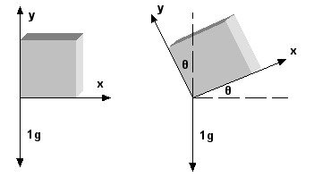
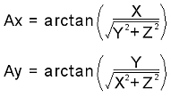
Algorithm for Static gesture recognition.

Slide 6

Angle
Flex Sensors
A
Kalman Filter
Degrees to Radians
SVM
Output

Slide 7
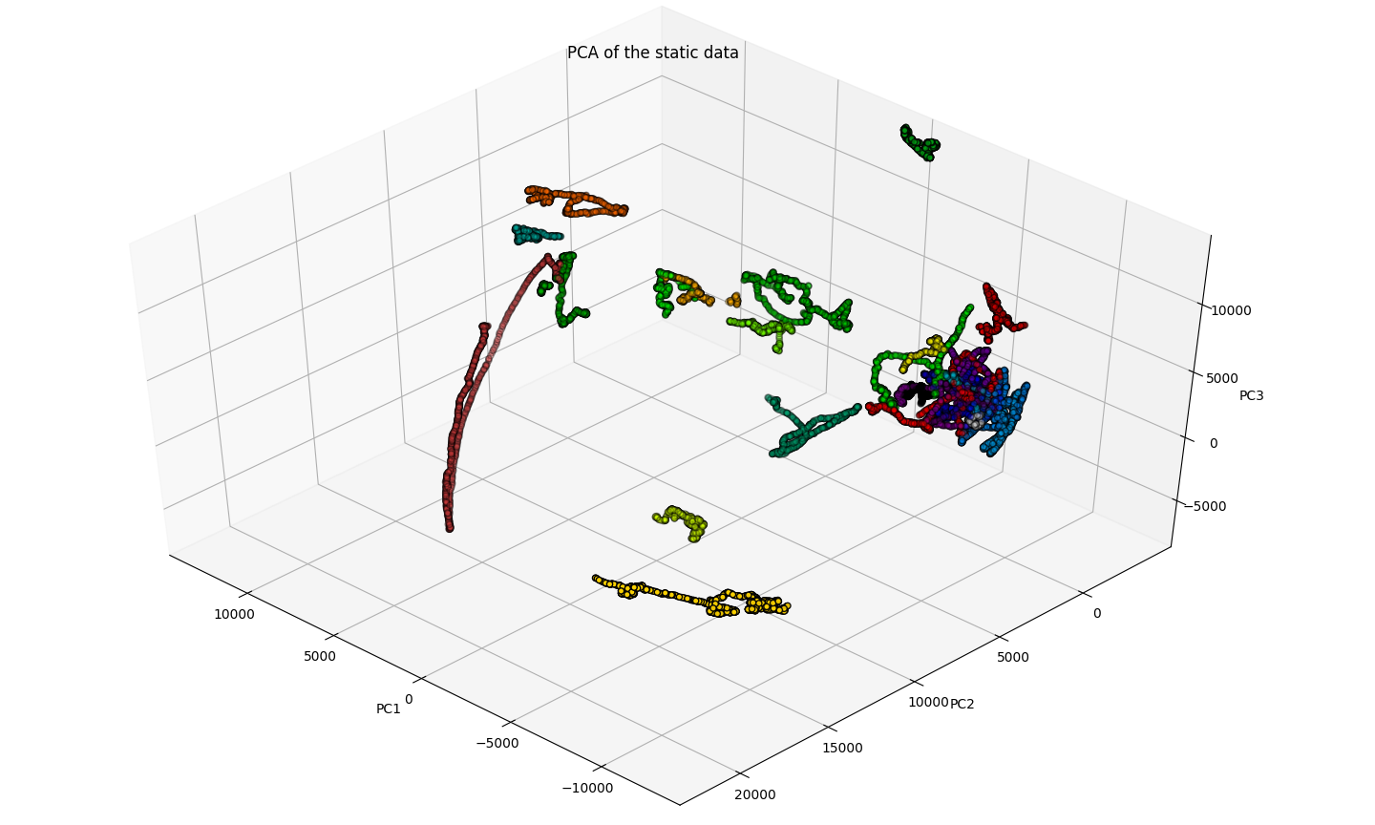
PCA for static gestures using all features.

Slide 8
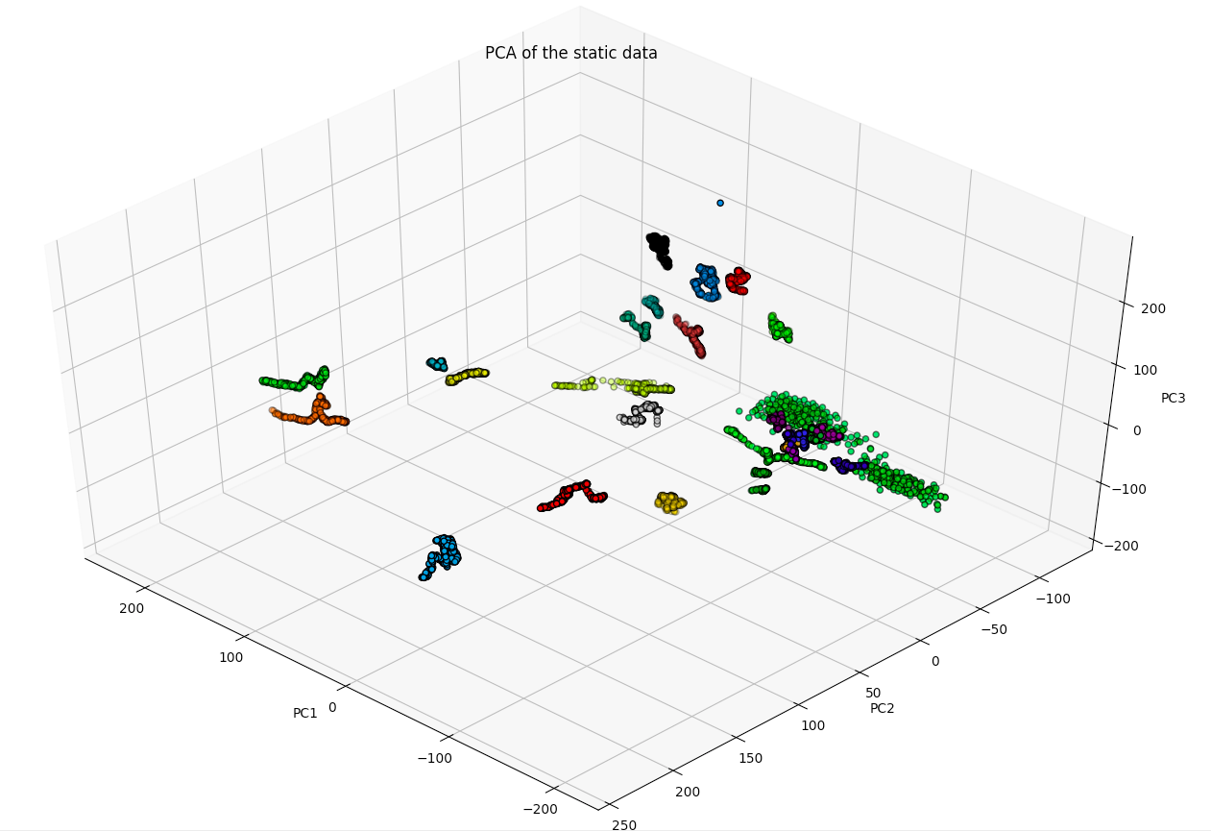
PCA for static gestures using the first ten features.

Slide 9
Algorithm for Dynamic gesture recognition.
Acceleration
Gyroscopic Acceleration
Angle
Flex
Sensors
Kalman Filter
Output
Temporary File
Normalise Column-wise
Sample out 50 points
SVM

Slide 10
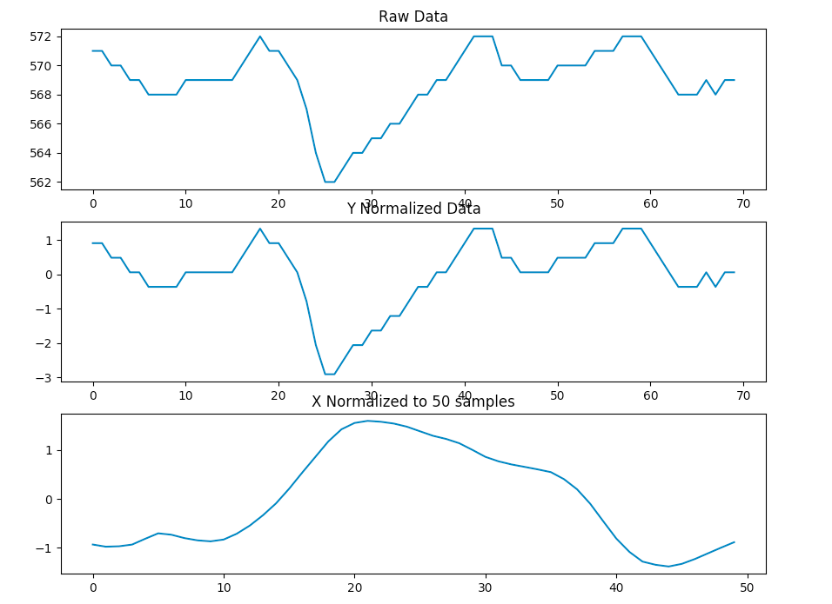
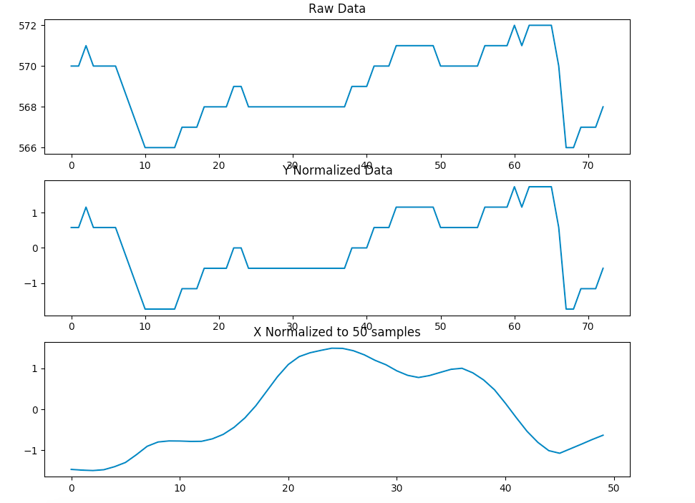
Comparison of x-axis acceleration for the “Door” gesture.

Slide 11
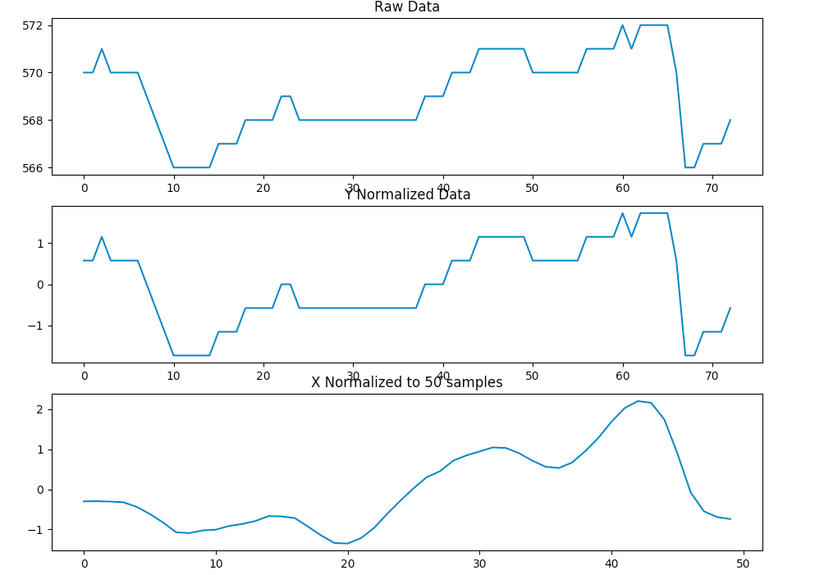
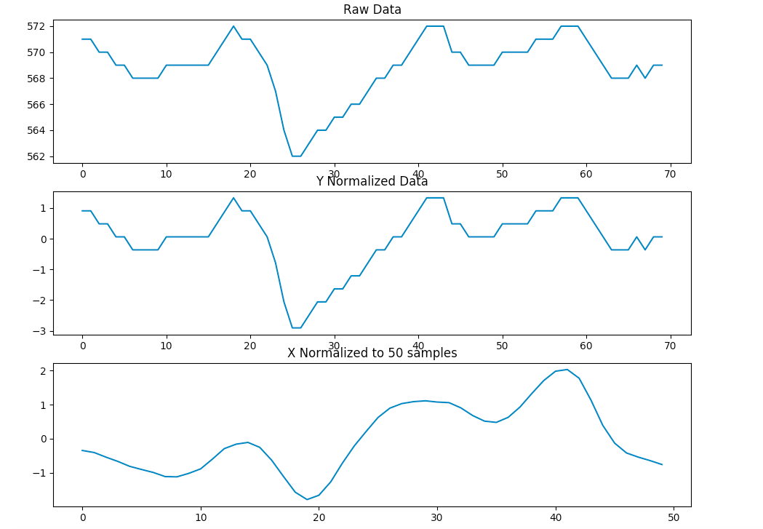
Comparison of y-axis acceleration for the “Door” gesture.

Slide 12
Salient Features of the System
No hindrance in motion.
Light weight.
The system can recognise 27 static gestures and 12 dynamic gestures.
Can be improved by using a Neural Network and gathering more data.
Number of static gestures can be increased
An easy mechanism to collect new data points.
The size of can be reduced by using a custom made board.
Can be made wireless.

Slide 13
Cost Report
Item | Number | Cost (INR)
Arduino Mega ADK | 1 | 650/-
MPU-6050 | 1 | 150/-
Flex Sensor | 7 | 3500/-
Gloves,Armband, Wrist Band | — | 1000/-
Raspberry Pi Zero | 1 | 1000
Miscellaneous | — | 500/-
Total |  | 5800/-

